Slide 1







25-26 Benefits

Slide 2
WHAT IS OPEN ENROLLMENT
Time to review benefit coverage options that are best for you, such as:
Update Dependent Information (Social Security Numbers and Date of Birth)
Ensure Dependents’ names match that of their Social Security
Add or drop Medical, Dental & Vision Plans
Add/Drop Voluntary Benefits (EOI may be required)
Add or drop a dependent to plan(s)
Enroll/Re-enroll in the HSA
Review Coverage Options
Add/Edit your beneficiaries
Gather dependent information for dependent audit (required for all dependents previously not audited)

Slide 3

WHAT IF YOU MISS OPEN ENROLLMENT
If you miss your enrollment window (first 60 days of employment), you will have to wait until the 2026 open enrollment to make changes unless you have a qualifying life event.

Slide 4
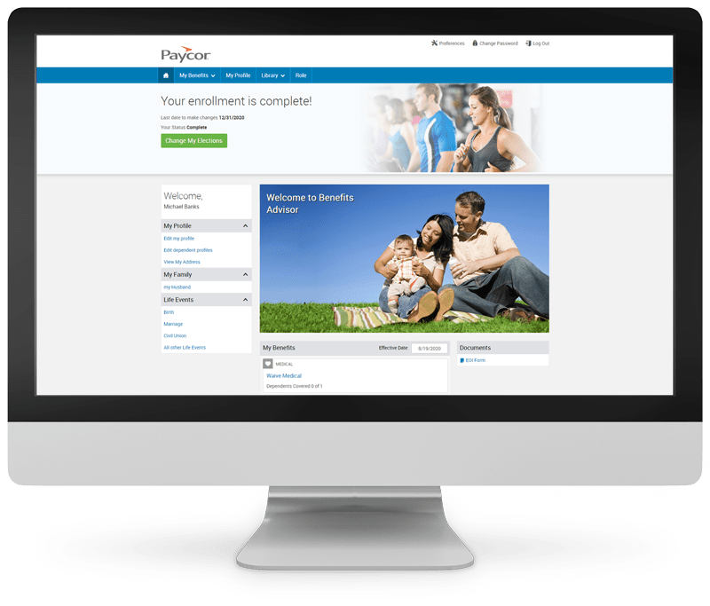
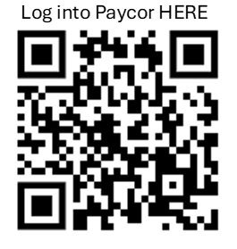
HOW TO ENROLL
1st – read your enrollment materials, including your Benefits Guide. We encourage you to consider your options carefully and make informed decision.
2nd –Gather information for any dependents and beneficiaries you need to update, including date of birth and address.
3rd – Enroll. You only have one way to enroll. You can self- enroll by logging into your Paycor account, by your enrollment deadline, and make any necessary changes.

Slide 5

BENEFITS AVAILABLE FOR 2025 - 2026
Great News!
Benefit plan designs are remaining the same for the medical, dental, vision, life and disability, and the voluntary benefits!
Dental rates through Mutual of Omaha have decreased.
New offering of Pet Insurance through Spot Pet! Rates are based on your location, age, breed of dog or cat and you are billed directly from Spot Pet.
Life & ADD benefit amounts will be based on years of service (BBMA Pays for this benefit).
We encourage you to read all of your enrollment materials, including the Benefit Guide, and join a live webinar to learn about all the benefits available to you as Big Blue Marble Academy employee.

Slide 6

ELIGIBILITY
Who can enroll?
  Employees working at least 30 hours per week
  Legal spouse (spousal affidavit required)
  Children under the age of 26 (or a child of any age who is medically certified as disabled and dependent on you for support and maintenance)
When can you enroll?
  Within 60 days of your date of hire
  During annual open enrollment
  Within 31 days of a Qualifying Life Event

Slide 7
MEDICAL PLANS & RATES

Slide 8
IMPORTANT TERMS TO KNOW
Health care can be difficult to navigate and all of the jargon doesn’t help to make things less complicated. Here’s a breakdown to help you better understand your benefits, bills and coverage.
Deductible – The amount you have to pay out-of-pocket for medical expenses before the insurance company will cover any benefit costs for the year. If your deductible is $5,000, your insurance plan will begin to help with payments once you’ve reached that amount. Remember, in-network preventive care visits are always 100 percent covered.
Out-of-Pocket Maximum – The most you would possibly pay out-of-pocket for covered services in a year. Once you reach your out-of-pocket maximum, your plan covers all eligible expenses. Some plans have separate out-of-pocket maximums for medical and prescription drugs.
Premium - Like your 12-month gym membership, this is the base amount you pay every month for health care coverage, whether or not you use it.
Copay - A flat fee paid to your provider at the time of service. You might also pay copays for prescription drugs.
Claim –When your visit providers, they will submit claims to your insurance company for the services you received . Once your insurance pays their share, you’ll receive a bill for the rest.
Coinsurance – The cost share between you and the insurance company. Coinsurance is always a percentage totaling 100 percent. For example, if the plan pays 70 percent, you are responsible for paying the remaining 30 percent of the cost.

Slide 9
BCBS MAJOR MEDICAL PLANS & PHARMACY PLAN FEATURES
 | Base Plan HDHP |  | Mid Plan PPO 3k |  | Buy Up Plan PPO 3.5k
 | In-Network | Out of Network ** | In-Network | Out of Network ** | In-Network | Out of Network **
Deductible | $5,000 $10,000 | $7,000 $14,000 | $3,000 $6,000 | $6,000 $12,000 | $3,500 $7,000 | $7,000 $14,000
Out-of-Pocket Maximum | $7,000 $14,000 | $14,000 $28,000 | $7,500 $15,000 | $15,000 $30,000 | $7,500 $15,000 | $15,000 $30,000
Coinsurance* | 30% | 50% | 30% | 50% | 10% | 40%
Preventive Care | $0 | Not Covered | $0 | Not Covered | $0 | Not Covered
Office Visit | 30% | 50% | $50 | 50% | $25 | 40%
Specialist | 30% | 50% | $50 | 50% | $45 | 40%
Online Dr Visit | 30% | Not Covered | $50 | Not Covered | $25 | Not Covered
Diagnostic Lab & X-ray Lab/Low-Tech Imaging High-Tech Imaging | 30% 30% | 50% 50% | 30% 30% | 50% 50% | 10% 10% | 50% 50%
Urgent Care | 30% | 50% | $50 | 50% | $45 | 40%
Emergency Room | 30% |  | 30% |  | 10%
Outpatient Care | 30% | 50% | 30% | 50% | 10% | 40%
Inpatient Care | 30% | 50% | 30% | 50% | 10% | 40%
Prescription Drugs
Generic, Retail 31-day | 30% | Not Covered | $8 | Not Covered | $10 | Not Covered
Preferred, Retail 31-day | 30% | Not Covered | $45 | Not Covered | $35 | Not Covered
Non-Preferred, Retail 31-day | 30% | Not Covered | $65 | Not Covered | $65 | Not Covered
Specialty, Retail 31-day | 30% | Not Covered | 30% | Not Covered | 0%* | Not Covered
Mail Order, 90-day | 30% | Not Covered | 2.5x Retail | Not Covered | 2.5x Retail | Not Covered

Slide 10

BCBS MAJOR MEDICAL PLANS NEW RATES
Bi-weekly Payroll Contributions
 | Base Plan HDHP | Mid Plan PPO 3k | Buy Up Plan PPO 3.5k
Employee | $36.96 | $67.62 | $111.78
Employee + Spouse | $136.60 | $220.66 | $301.00
Employee + Children | $109.51 | $177.16 | $242.04
Family | $192.29 | $310.99 | $424.80

Slide 11
BCBS MAJOR MEDICAL ADDITIONAL PROGRAMS
Health Coaching
Chronic Conditions Support
BlueCare Advocacy
Baby Yourself

Slide 12
HSA OVERVIEW
The HSA is a personal savings account that you can use for eligible healthcare expenses, like prescription drug copays, the cost of doctor’s office visits, and dental and vision expenses.
Our HSA is administered by Medcom and is available to anyone enrolled in the Base HDHP plan. It helps you set aside pre-tax dollars for healthcare now or in the future.
IRS Maximum Amount of HSA Contributions
 | 2025 | 2026
Single | $4,300 | $4,400
Family | $8,550 | $8,750
The amounts above are for the 2025 or 2026 tax year. Catch Up Contributions • If you are between age 55 to 65, you may contribute an additional $1,000.
Triple Tax-Advantaged
No tax on contributions
No tax on interest earned
No tax when you withdraw for eligible expenses
Your HSA is your own individual account:
You decide how to spend the money
The funds go with you, even if you leave BBMA
Money rolls over from year to year; no use it or lose it

Slide 13
MINIMUM ESSENTIAL COVERAGE (MEC) PLANS
Minimum Essential Coverage (MEC) Plans
 | MEC Plan 1 | MEC Plan 2
Preventive Care | Included - no cost share | Included - no cost share
Teladoc Telemedicine (Through HealthiestYou) | Unlimited No Cost Visits | Unlimited No Cost Visits
Doctor Office Visit | Pays $100/day, 4 days per year | Pays $100/day, 6 days per year
Diagnostic X-ray | Pays $70/day, 4 days per year | Pays $100/day, 2 days per year
Lab Tests | Pays $35/day, 3 days per year | Pays $45/day, 3 days per year
Major Diagnostic & Imaging | Pays $300/day, 2 days per year | Pays $400/day, 2 days per year
Emergency Room - Sickness | Pays $100/day, 2 days per year | Pays $200/day, 2 days per year
Emergency Room - Accident | "$100 deductible, then pays up to $2,500 per occurrence" | "$100 deductible, then pays up to $5,000 per occurrence"
Outpatient Surgery | Not Covered | Pays $500/day, 1 day per year
Outpatient Anesthesia | Not Covered 25% of Surgical Benefit
Hospital Admission Benefit | Pays $500 when admitted | Pays $1000 when admitted
Inpatient Daily Hospital Benefit | Pays $50/day, 30 days per year | Pays $300/day, 30 days per year
Inpatient Surgery | Not Covered | Pays $1,000/day, 1 day per year
Inpatient Anesthesia | Not Covered | 25% of Surgical Benefit
AD&D | $5,000 | $10,000
Specified Illness Benefit | Not Covered | $2,500 Lump Sum
Prescription Drugs
Generic Rx Coverage | $10 indemnity/day, 12 days per year | $10 indemnity/day, 24 days per year
Brand Rx Coverage | Discount | $50 indemnity/day, 24 days per year

Slide 14

MEC PLAN – NO RATE CHANGE
MEC Contributions Bi-Weekly Payroll Contributions
 | Plan 1 | Plan 2
Employee | $0.00 | $11.70
Employee + Spouse | $18.96 | $36.85
Employee + Childr(en) | $19.44 | $32.46
Family | $47.06 | $52.08

Slide 15
DENTAL COVERAGE & RATES

Slide 16

DENTAL PLAN COMPARISON
Key Dental Benefits | Low Plan | High Plan
Deductible (Individual / Family) | $50 / $150 | $50 / $150
Coinsurance
Preventive Services (Exams, bitewing x-rays, cleanings, fluoride treatments (up to age 14), space maintainers, sealants) | Covered in Full | Covered in Full
Basic Services (Fillings, periodontics, endodontics, non-surgical extractions) | 20% | 20% Includes surgical extractions
Major Services (Crowns, inlays, onlays, bridges, dentures) | Not Covered | 50%
Orthodontia —for children through age 26 | Not Covered | 50%
Benefit Maximum
Per Individual Per Year | $1,000 | $1,500 + Rollover
Orthodontia Lifetime Max | Not Applicable | $1,500
Dental Bi-Weekly Payroll Rates
 | Low Plan | High Plan
Employee | $8.62 | $15.06
Employee + Spouse | $19.78 | $28.40
Employee + Child(ren) | $21.92 | $42.65
Family | $33.46 | $60.16

Slide 17
VISION COVERAGE & RATES

Slide 18

VISION PLAN HIGHLIGHTS
Key Vision Benefits | In-Network | Out-of-Network Reimbursement
Exam (once every 12 months) | $10 | Up to $37
Prescription Glasses (once every 12 months for lenses; every 24 months for frames)
Frame | $0, $130 Allowance | Up to $58
Lenses Single Bifocal Trifocal Lenticular | $25 Copay | Up to $20 Up to $36 Up to $64 Up to $64
Contact Lenses (once every 12 months; instead of glasses)
Conventional | Up to $130 Allowance | Up to $89
Disposable | Up to $130 Allowance | Up to $104
Medically Necessary | $0, covered in full | Up to $210
Vision Payroll Rates
 | Biweekly
Employee | $3.30
Employee + Spouse | $7.06
Employee + Child(ren) | $5.72
Family | $9.48

Slide 19
LIFE/AD&D INSURANCE

Slide 20

BASIC LIFE / AD&D (based on years of service)
Basic Life and AD&D
Life and accidental death and dismemberment (AD&D) insurance help protect your family’s financial security against the unexpected. BBMA provides a basic life and AD&D insurance benefit based on years of service. This benefit is provided at no cost to all eligible employees.

Slide 21

VOLUNTARY LIFE / AD&D
 | EMPLOYEE | SPOUSE | CHILD (Up to age 26)
Benefit Amount | Increments of $10,000 (minimum $10,000) | Increments of $5,000 (minimum $5,000) | Increments of $1,000 (minimum $2,000)
Benefit Maximum | 5x covered annual earnings up to $500,000 | 100% of EE amount up to $250,000 | $10,000
Guarantee Issue | 5x covered annual earnings up to $150,000 | 100% of EE amount up to $50,000 | $10,000
Benefit Limitations | 35% at age 65, 50% at age 70 and 75% at age 75 | Spouse coverage terminates when you reach age 70 | 14 days to age 26
Bi-Weekly Voluntary Life and AD&D Rates (Per $1,000 of Benefit)
Age | <29 | 30-34 | 35-39 | 40-44 | 45-49 | 50-54 | 55-59 | 60-64 | 65-69 | 70+
Employee/ Spouse | $0.092 | $0.104 | $0.156 | $0.252 | $0.389 | $0.633 | $0.995 | $1.38 | $2.549 | $4.312
Child | $0.20
*Employees exceeding the guaranteed issue amount must complete an EOI form which is accessible via a link during your Paycor enrollment*

Slide 22
DISABILITY INSURANCE

Slide 23
SHORT-TERM & LONG-TERM DISABILITY
Short Term Disability
Benefit Amount | 60% of covered weekly earnings
Benefit Maximum | $1,250
Benefits Begin On | Injury / Sickness: on the 15th day of disability
Maximum Benefit Period | Up to 11 weeks
Pre-Existing Condition Limitations | 3/6
Long Term Disability
Benefit Amount | 60% of covered monthly earnings
Benefit Maximum | $6,500
Benefits Begin On | On the 91st day of disability
Maximum Benefit Period | 5 Years
Pre-Existing Condition Limitations | 12/12

Slide 24

EAP PROGRAM
BBMA recognizes that personal and family problems can impact your life at home and at work. That’s why we offer the EAP to give you access to help when you need it most.
The EAP is completely confidential and free for you. Through this program, you and your household family members can get up to three confidential sessions with a counselor.
Use the EAP when you need help with things like:
Family, parenting or relationship concerns
Child or elder care
Financial questions
Depression, stress and anxiety
Legal issues
Grief and loss
Drug or alcohol abuse
Will preparation (extra fees apply)
Contact Mutual of Omaha EAP at 800-316-2796 or visit mutualofomaha.com/eap

Slide 25
VOLUNTARY WORKSITE BENEFITS

Slide 26
VOLUNTARY BENEFITS
The following benefits are offered through Mutual of Omaha. For more details and rates, please consult the plan documents.. You can only sign up for these benefits during open enrollment.
Accident Insurance
Accident insurance can pay you money based on the injury and the treatment you receive, whether it’s a simple sprain or something more serious, like an injury from a car accident. Your plan can pay you a benefit for an emergency room treatment, stitches, crutches, injury-related surgery and a list of other accident-related expenses. The money is paid directly to you, and you decide how to spend it. If you elect coverage for yourself, you can also elect to cover your eligible dependents.
Hospital Indemnity
Our hospital indemnity plan helps cover unexpected costs when you’re admitted to the hospital for a covered illness or injury, or for childbirth. You receive a lump-sum payment for hospital admission and daily hospital benefit. You can use the money for any expenses (medical or non-medical).
Critical Illness Insurance
Critical illness insurance can help by paying a lump sum payment directly to you when you’re diagnosed with a covered condition, whether it’s early stage diagnosis or a more serious illness. You decide how to spend it. You can also purchase coverage for your spouse or your dependent children, at a percentage of your benefit amount.
Covered conditions include heart attack, stroke, end stage kidney failure, cancer and more. You can also get a $50 benefit per year if you get certain health screenings that help prevent these illnesses or detect them early on.

Slide 27


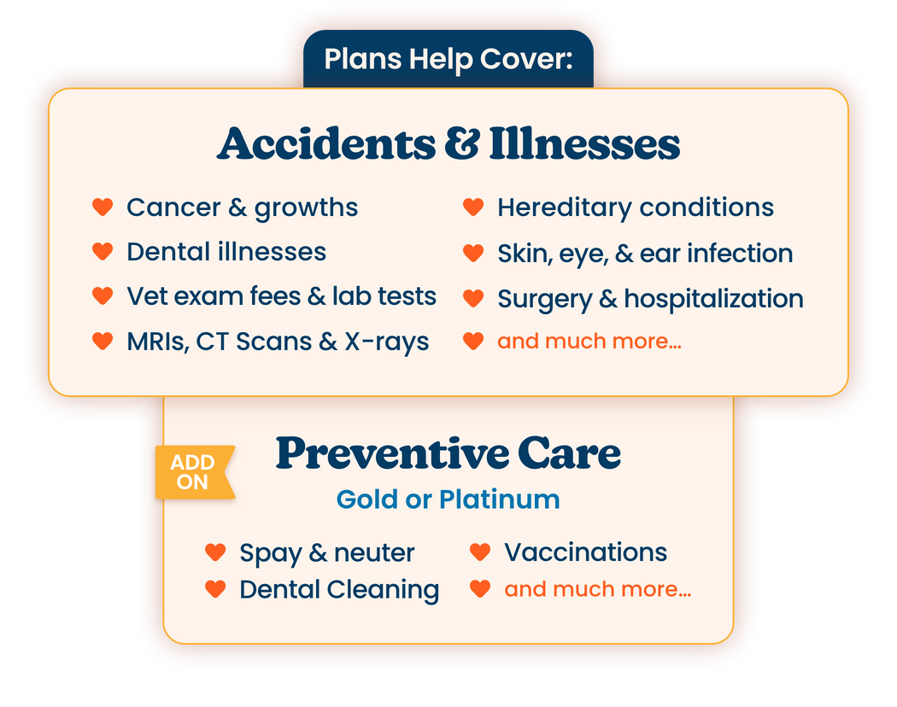

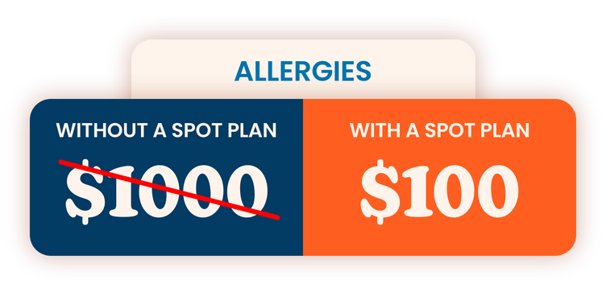
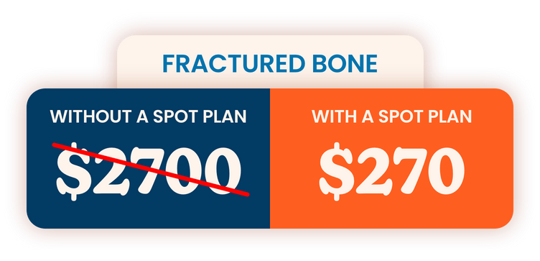


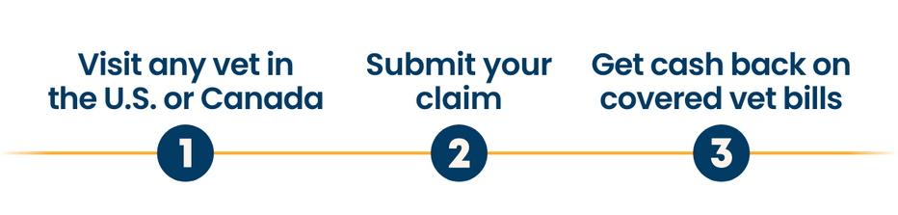

PET INSURANCE *NEW*
https://spotpet.link/bigblue
or call 888.343.2340
Priority Code is EB_DPS

Slide 28


PET INSURANCE
Signing up for America’s most-loved pet insurance is a walk in the park. Follow this easy guide to find the right plan for you BFF today!
Customize Your Pet’s Plan
Explore Preventive Coverage Add-Ons
  Spot’s GOLD and PLATINUM Wellness Plans offer optional preventive care coverage, with Platinum providing the highest reimbursement and boarder benefits – perfect for pet parents who want top-tier protection for routine exams, vaccines, and essential wellness services.
Choose a Payment Plan and Finalize
Additional Tips:
Maximize your benefits with the Platinum Plan, highly recommended for young pets.
If you need further assistance, please contact us by calling 888-343-2340

Slide 29
OPEN ENROLLMENT REMINDERS
DON’T FORGET
Gather information for any dependents and beneficiaries you need to update , including date of birth and address.
You only have one way to enroll. You can self- enroll by logging into your Paycor account and make any necessary changes.
Submit all elections within the first 60 days of employment.

Slide 30

QUESTIONS?
If you have additional questions, you may also contact Human Resources OR call the Free Employee Benefits Hotline
Tomi Laditan,
HR Director
tladitan@bbmacademy.com
Call the Free Employee Benefits Hotline
877-838-4779
Monday - Friday
10:00 a.m. to 8:00 p.m. EST
9:00 a.m. to 7:00 p.m. CST
7:00 a.m. to 5:00 p.m. PST
Email : advocates@hubinternational.com
Fax : 855.204.7146

